Slide 1
Project figures
3. VALIDATION ICGC

Slide 2
Mutational signatures
SKCA-BR
Notes:
N = 100

Slide 3
Notes:
ANOVA
Df Sum Sq Mean Sq F value Pr(>F)
Signature 30 169323 5644 78.32 <2e-16 ***
Residuals 3069 221157 72
--- Signif. codes: 0 ‘***’ 0.001 ‘**’ 0.01 ‘*’ 0.05 ‘.’ 0.1 ‘ ’ 1

Slide 5
Notes:
ANOVA
Df Sum Sq Mean Sq F value Pr(>F)
Signature 30 132404 4413 68.61 <2e-16 ***
Residuals 1519 97720 64
--- Signif. codes: 0 ‘***’ 0.001 ‘**’ 0.01 ‘*’ 0.05 ‘.’ 0.1 ‘ ’ 1

Slide 6
Mean sig contribution
Notes:
ANOVA
Df Sum Sq Mean Sq F value Pr(>F)
Signature 30 273894 9130 150.7 <2e-16 ***
Residuals 2852 172754 61
--- Signif. codes: 0 ‘***’ 0.001 ‘**’ 0.01 ‘*’ 0.05 ‘.’ 0.1 ‘ ’ 1

Slide 8
Survival analysis
CLINICAL ANNOTATIONS AND THERAPIES

Slide 9
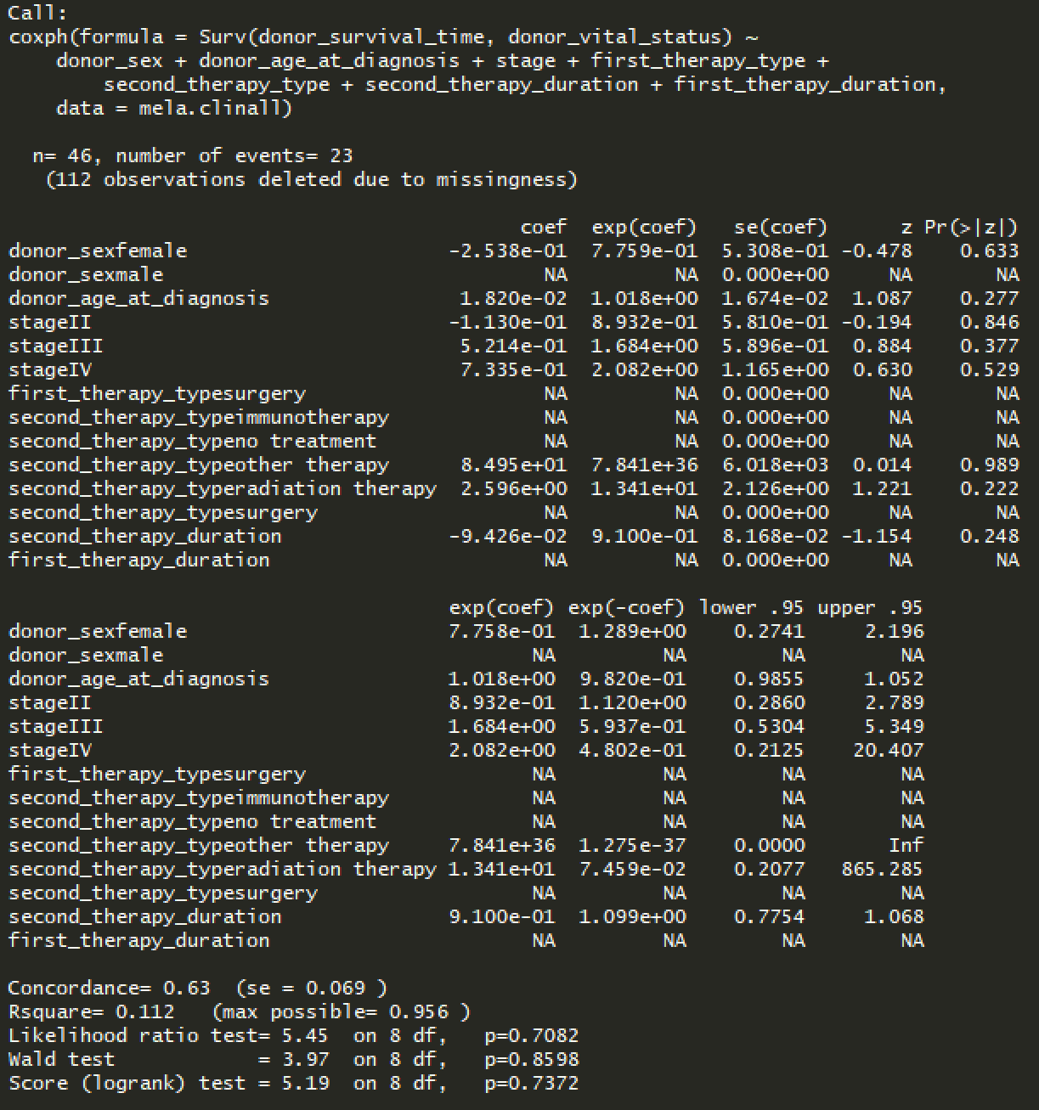
CoxPH model MELA-AU – sex age stage therapies
Notes:
Confirms result from TCGA that treatment doesn’t have much impact on survival

Slide 10
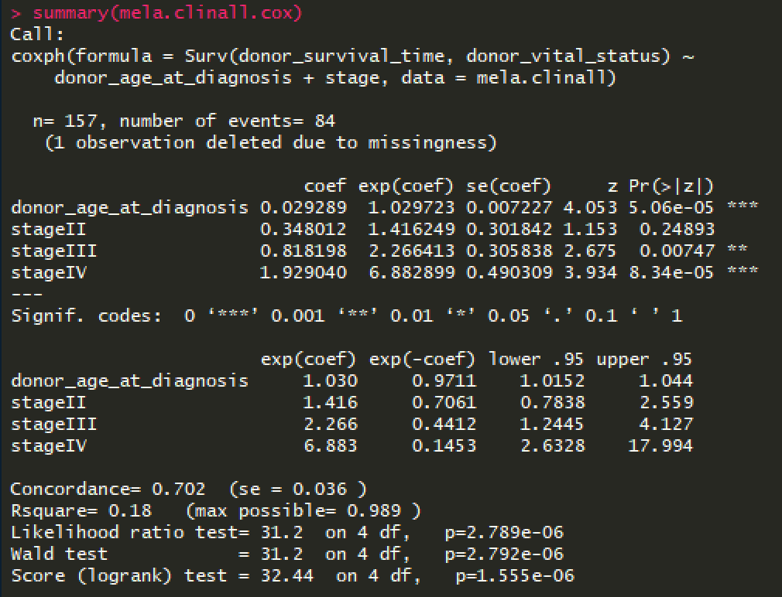
CoxPH model MELA-AU – age and stage
Vital status
1: dead
0: alive
Notes:
CLINICAL ONLY

Slide 11
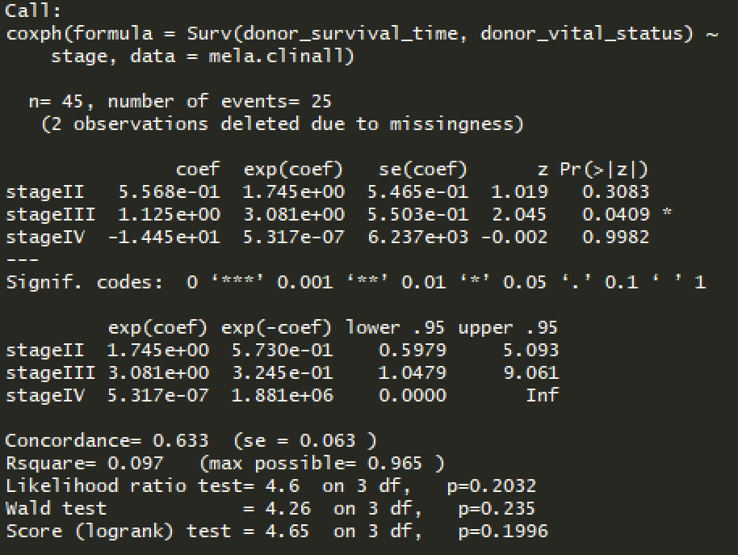
CoxPH model MELA-AU (50 samples)

Slide 12
Survival
SKCA-BR

Slide 13
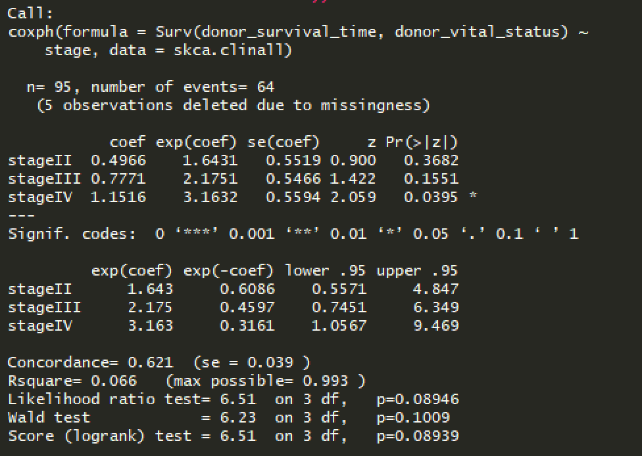
CoxPH SKCA-BR -- stage

Slide 14
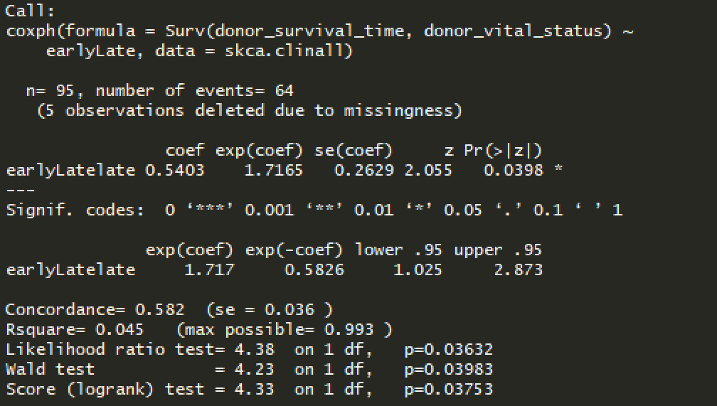
CoxPH SKCA-BR -- progression

Slide 15
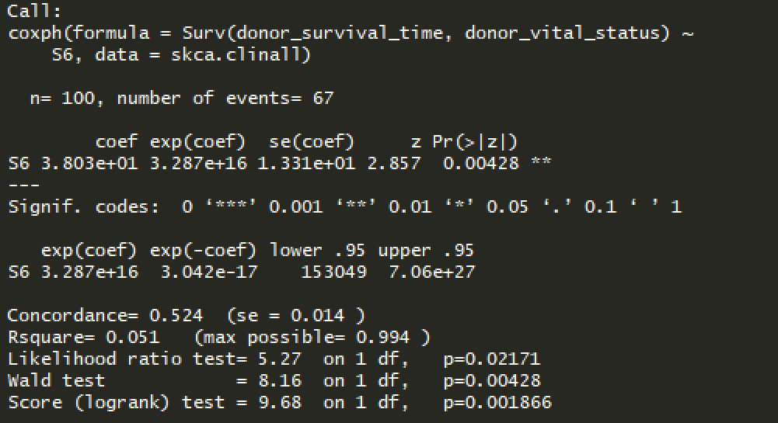
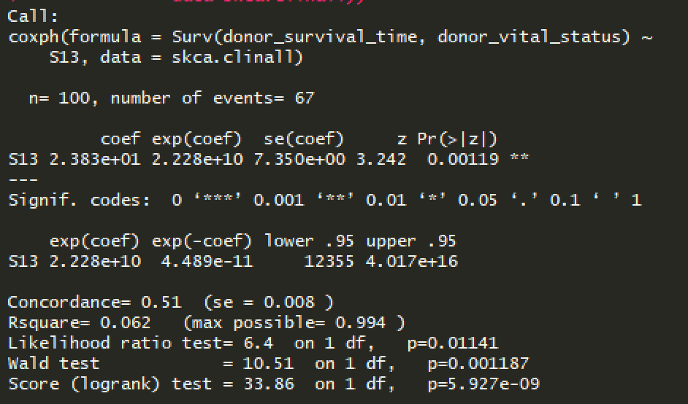
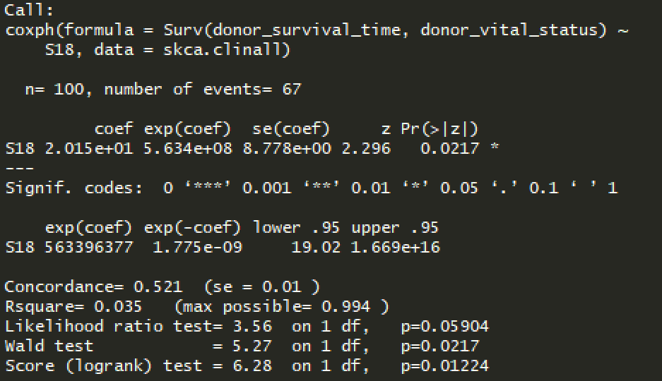
CoxPH SKCA-BR – sigs

Slide 16
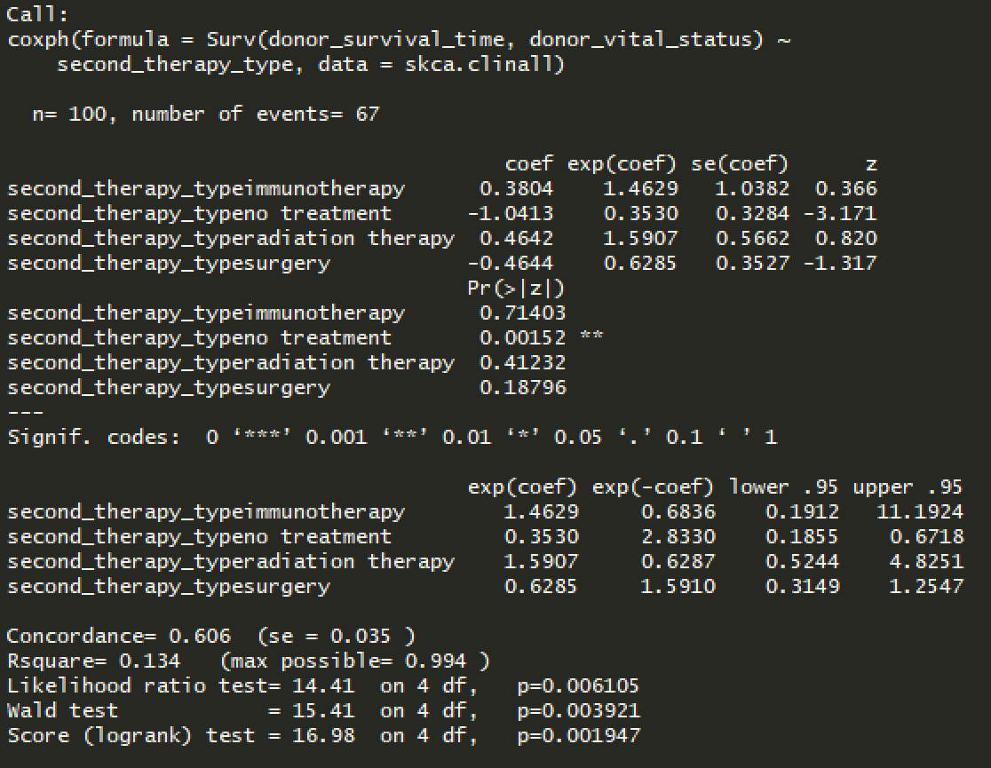
CoxPH SKCA-BR -- treatment

Slide 17
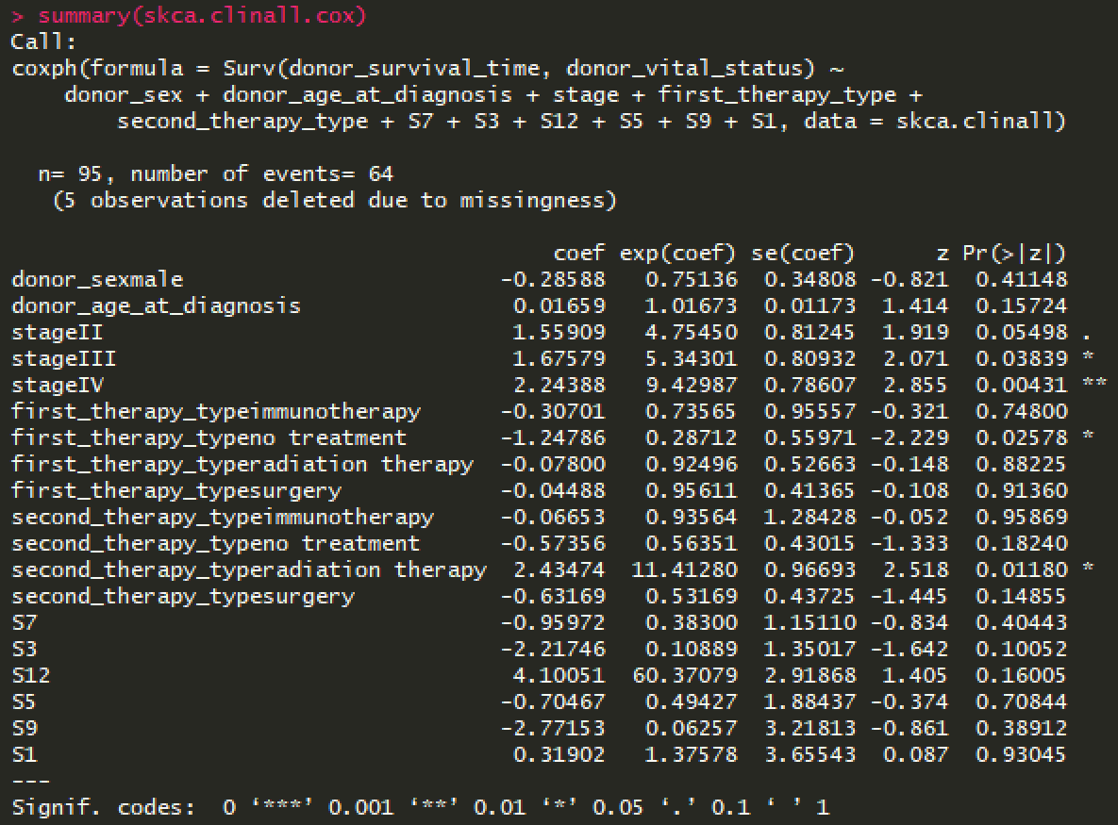
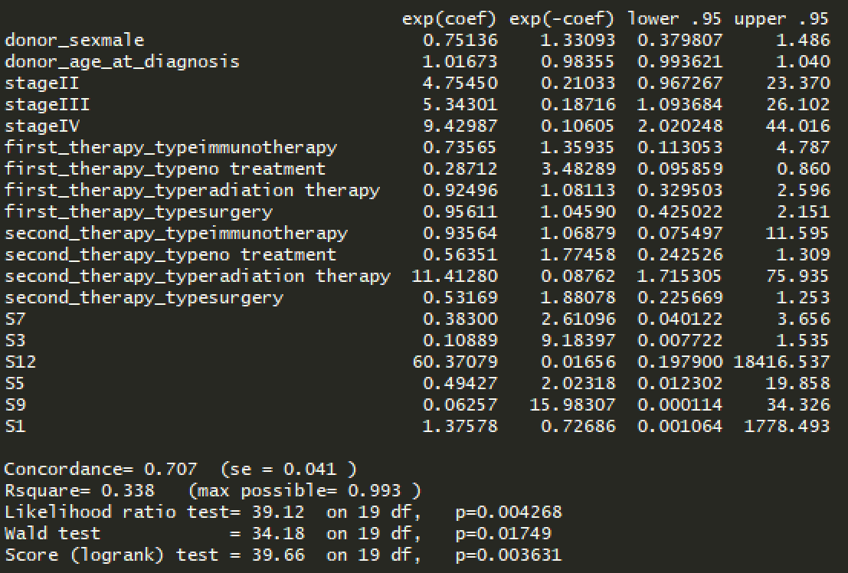
CoxPH model SKCA-BR – clinical and mutsigs
Notes:
Stage and first therapy significantly impact survival

Slide 18
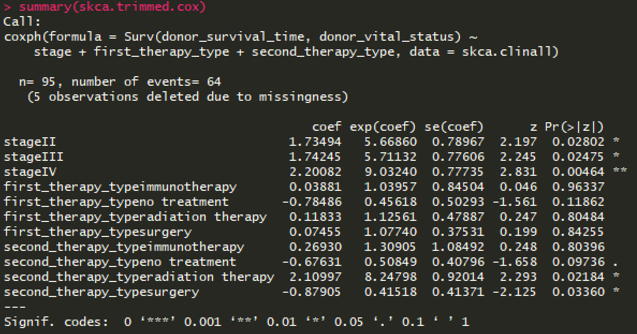
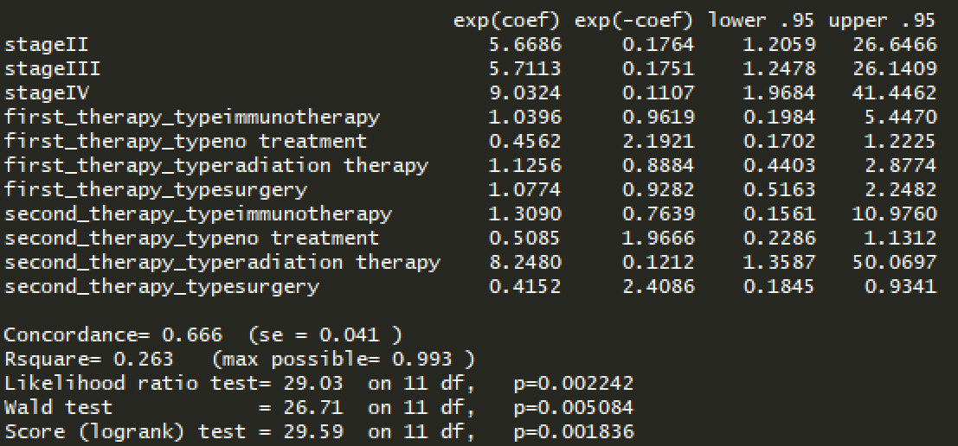
CoxPH model SKCA-BR – clinical trimmed
Vital status
1: dead
0: alive
Notes:
Stage and 2nd therapy type significantly impact survival

Slide 19
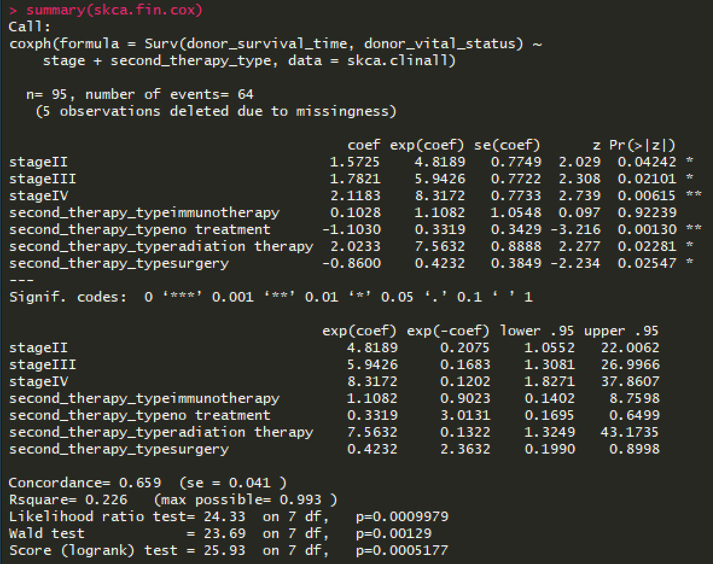
CoxPH model SKCA-BR – clinical final
Vital status
1: dead
0: alive
Notes:
Stage impacts survival, with later stage having a larger impact on the survival
Second therapy type was also impacting survival, with no treatment most significantly associated survival, although radiation and surgery were also significantly impacting

Slide 20
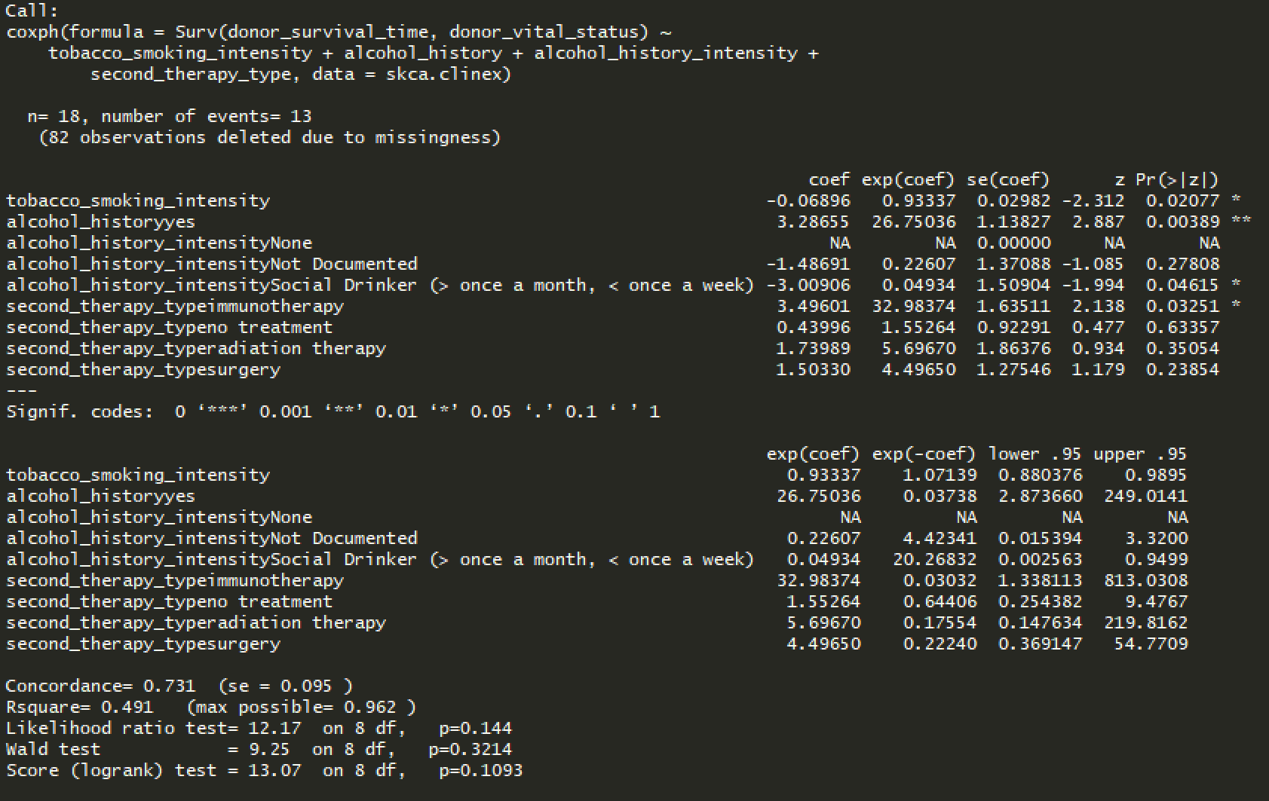
CoxPH model SKCA-BR – exposure and treatment
Notes:
Concordance good, pvals not good… Social drinker and immune therapy marginally significant, lots of observations deleted due to missingness

Slide 21
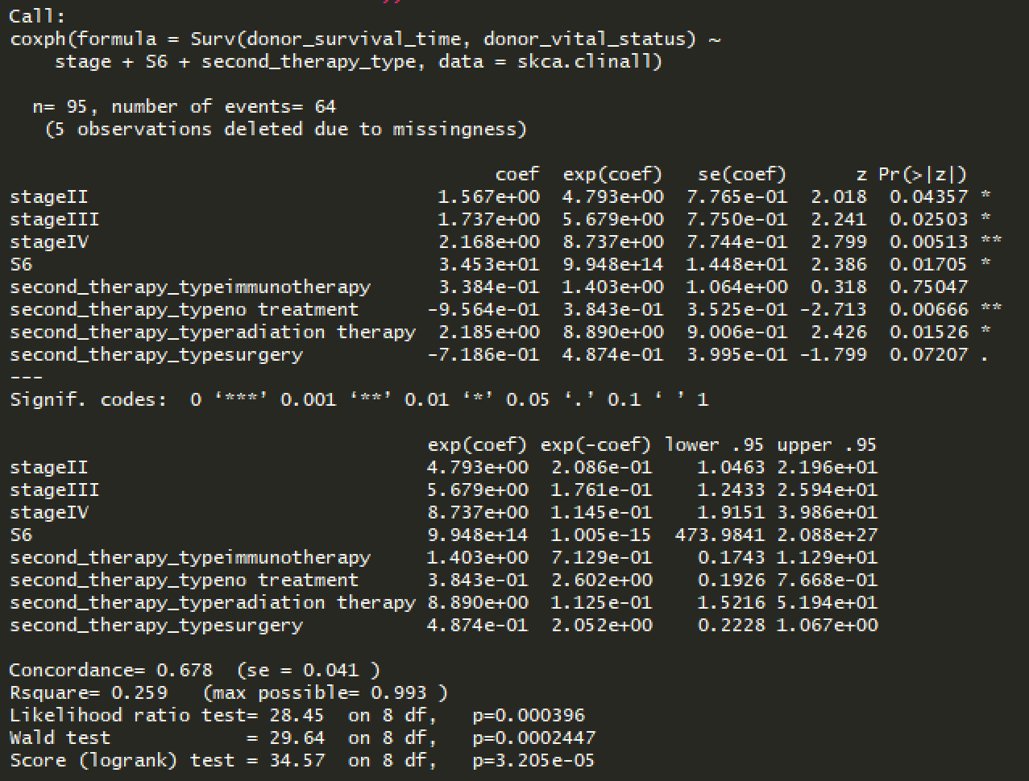
CoxPH SKCA-BR – stage + S6 + therapy

Slide 22
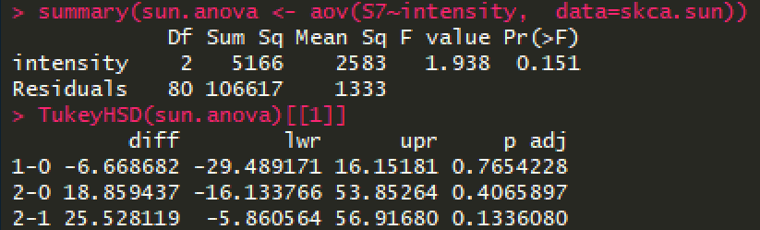

Slide 23
Survival (n=93)

Slide 24
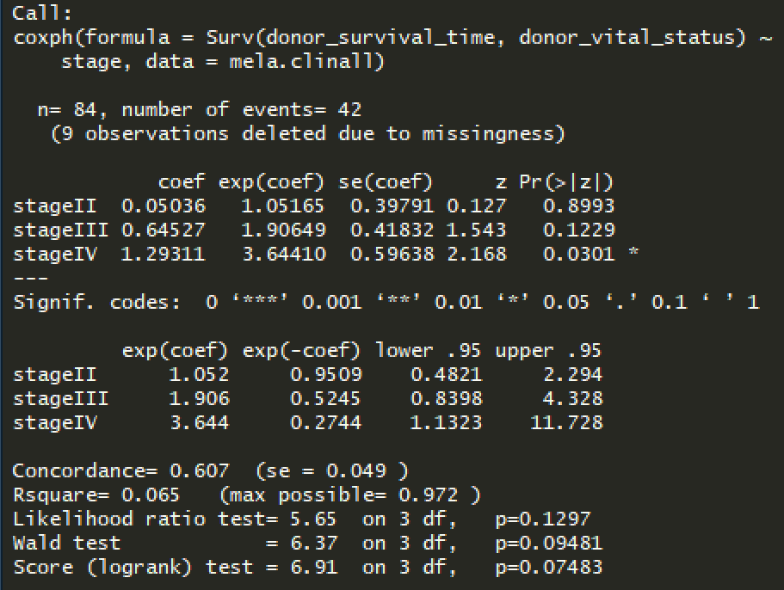
CoxPH MELA-AU -- stage

Slide 25
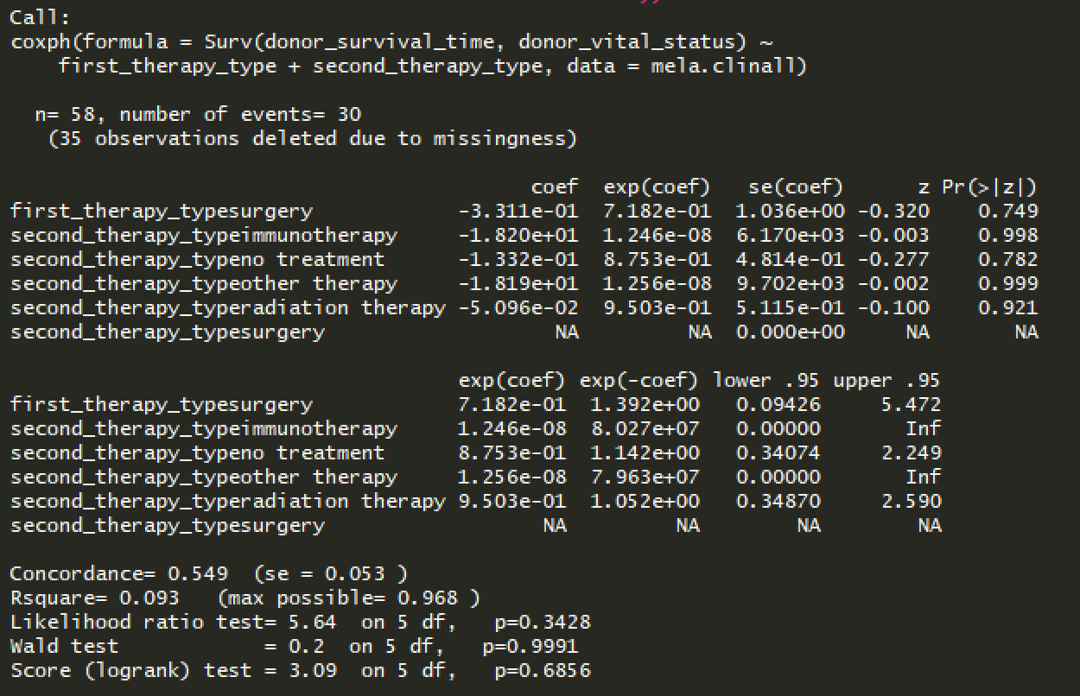
CoxPH MELA-AU -- therapies
Notes:
Ther + stage

Slide 26
Survival (n=107)
MELA-AU

Slide 27
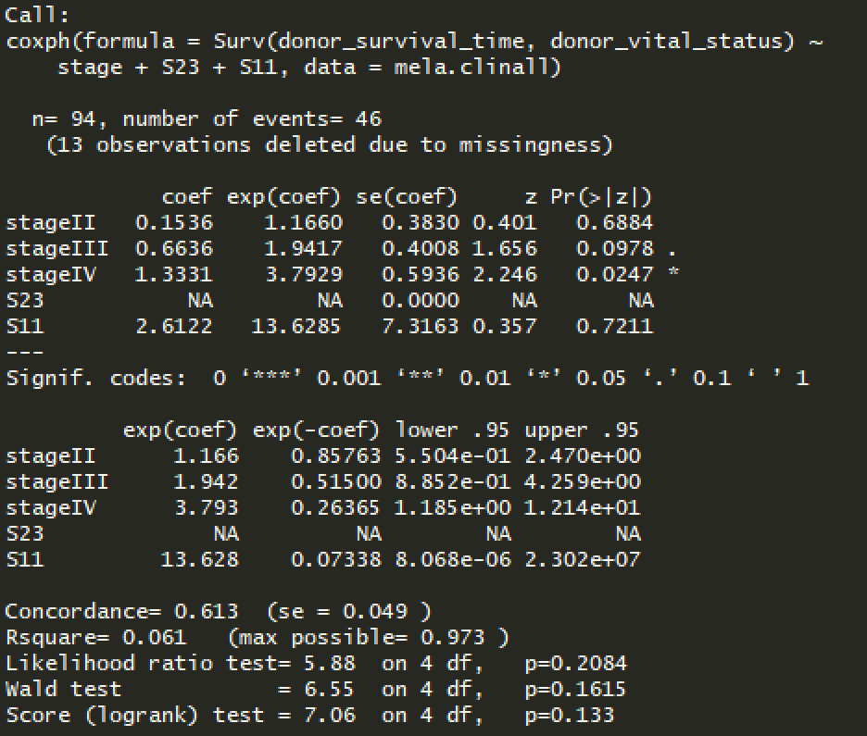
CoxPH model MELA-AU – SKCM TP model

Slide 28
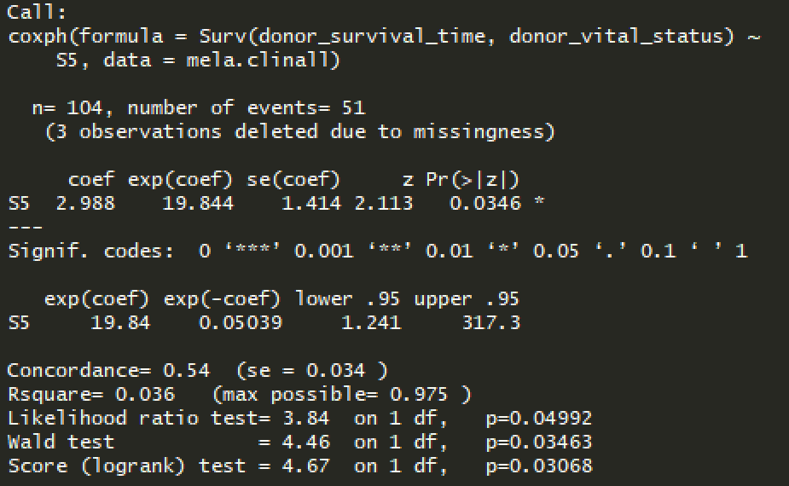
CoxPH model MELA-AU – S5

Slide 29
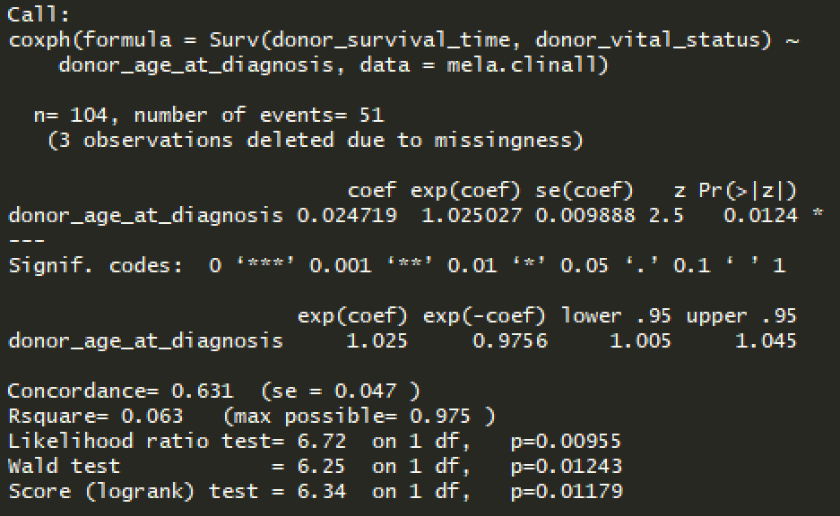
CoxPH model MELA-AU -- Age

Slide 30
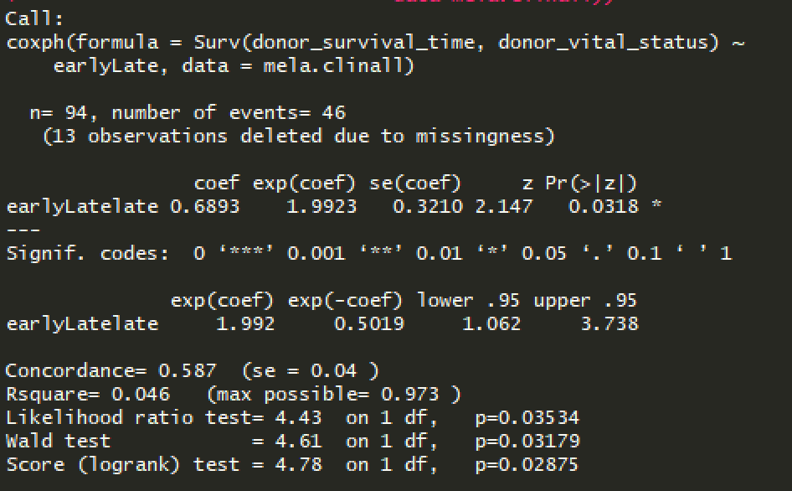
CoxPH MELA-AU -- progression

Slide 31
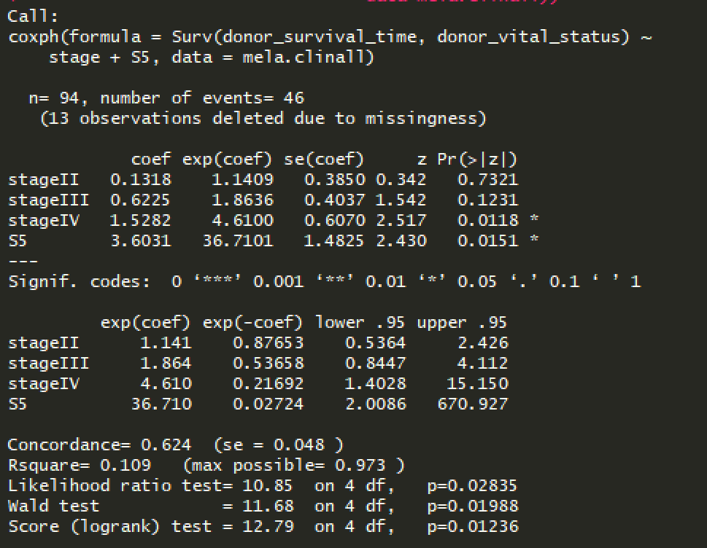
CoxPH MELA-AU
Notes:
Signature 5
Unknown etiology
Found in all cancer types and most samples
Exhibits transcriptional strand bias for T>C substitutions at ApTpN context.
Combine all datasets together, add column with cohort (stage +treat+cohort…)
Start w/o therapies,
stage, cohort, sigs
Report: derived model in internal cohort, in ext cohorts see seem to be other sigs that impact survival, diff risk factors in different countries + WES/WGS differences
To properly see impact of sigs on survival, need bigger cohort, need same tech to get consistent results
Conc → mut history of cells doesn’t really impact early metast prog, but do impact cancer prog longer term and patient survival, esp in background of spec treatment in melanoma
Divide other sigs by S1 to normalize
S1 vs age corr → really depends on cancer type, some occur earlier, also depends on when the first mut occurred, in theory should correlate but in practice doesn’t really happen
Could be due to deconstructSigs not able to deal with s1 very well
Focus on NER
Calculate correlations to see if any correlate, then plot
Identify a few that correlate with signature (S6, etc)
mutation data
- check: cbioportal

Slide 32
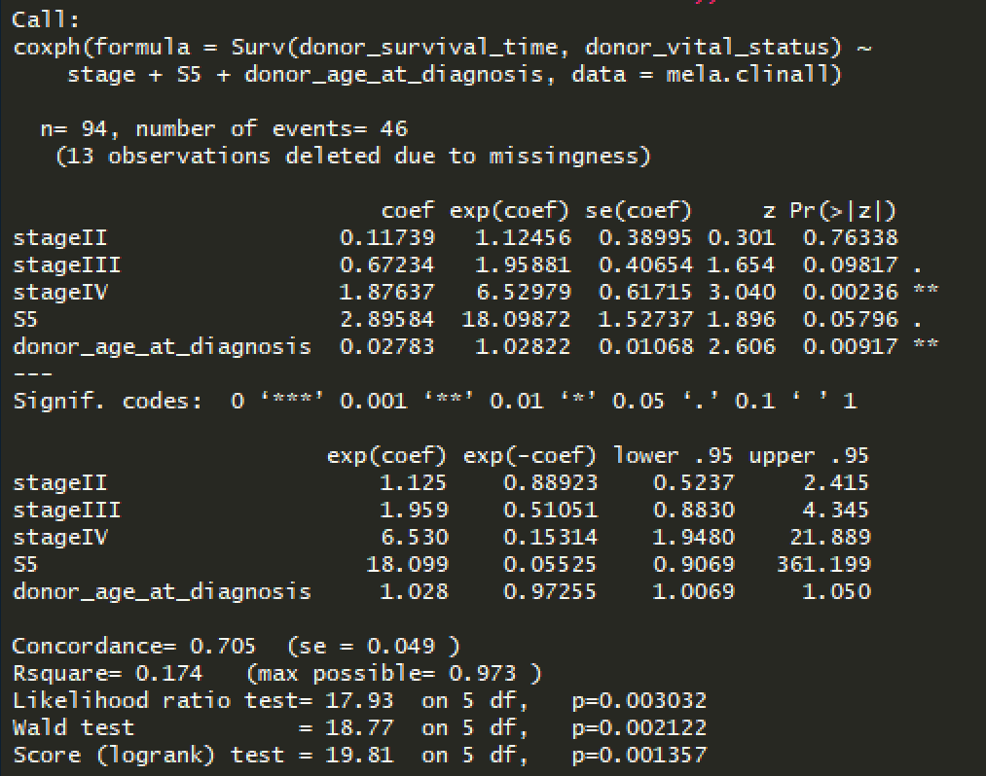
CoxPH MELA-AU – stage+S5+age

Slide 33
Survival models
COMBINED DATASETS

Slide 34
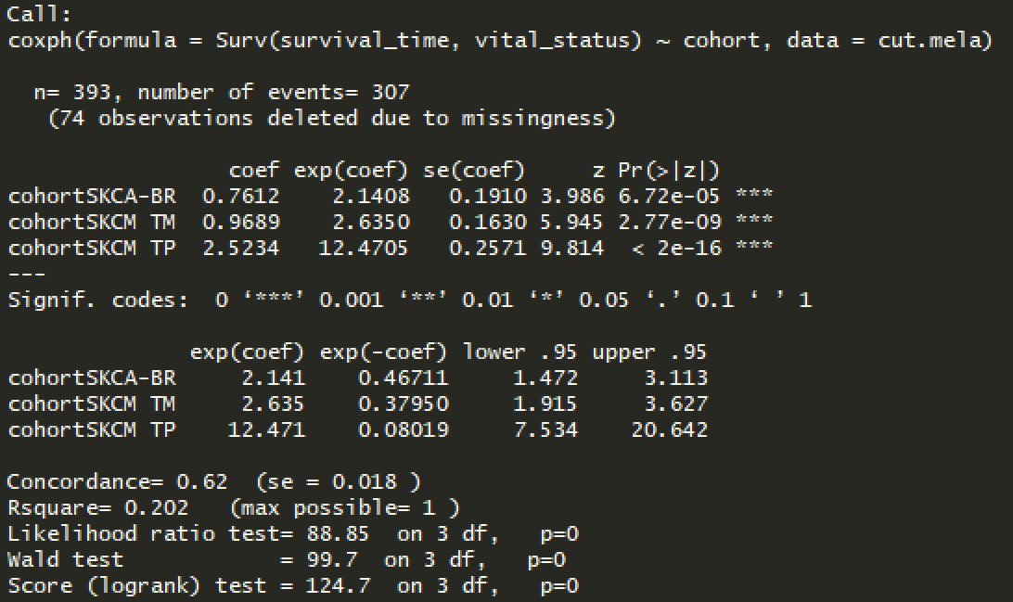
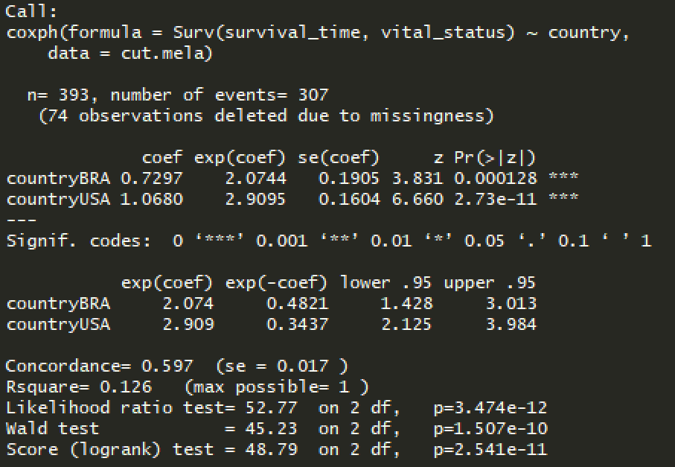
Cohort

Slide 35
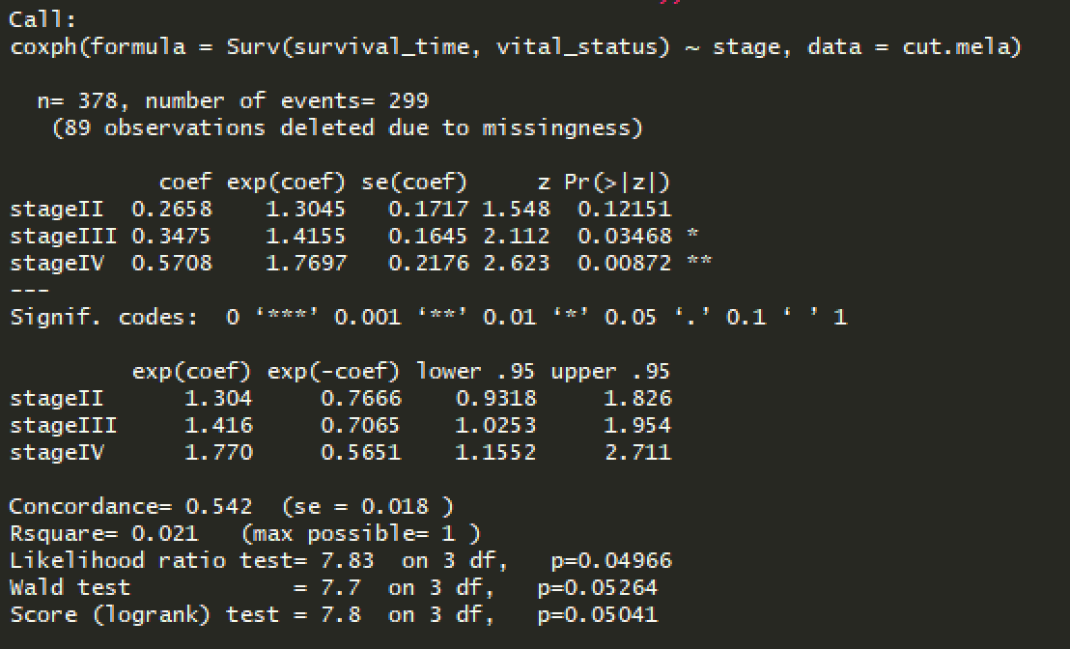
Stage

Slide 36
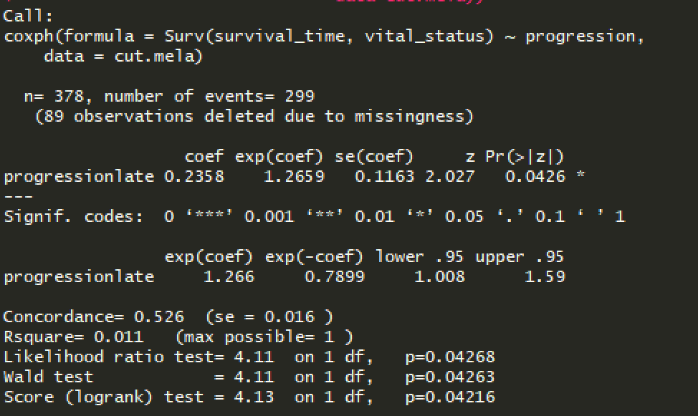
Progression

Slide 37
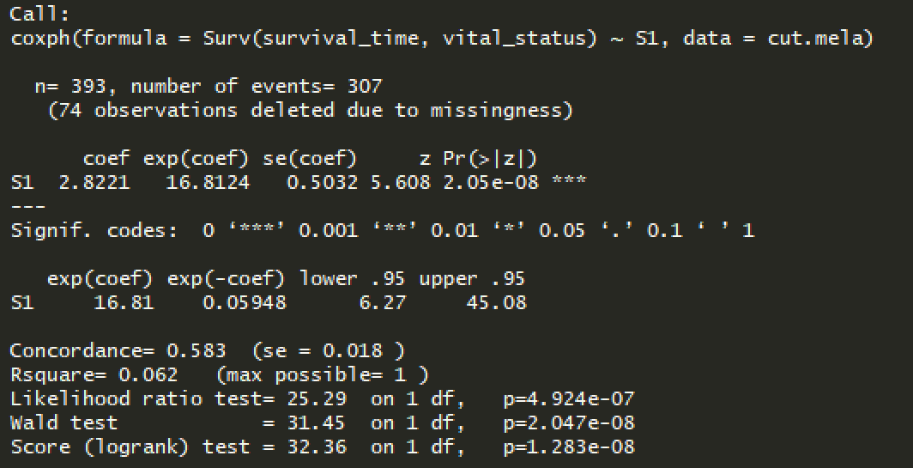
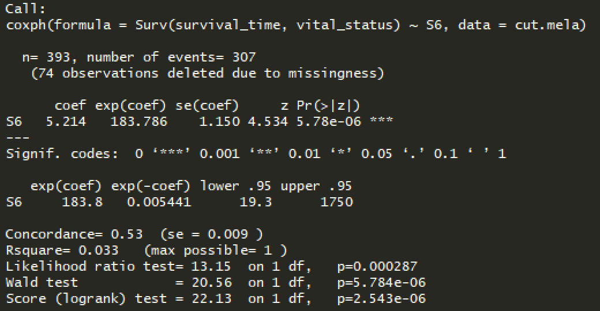
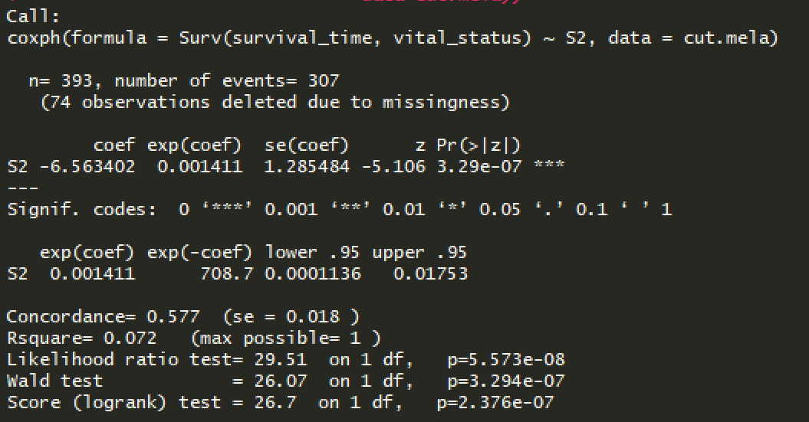
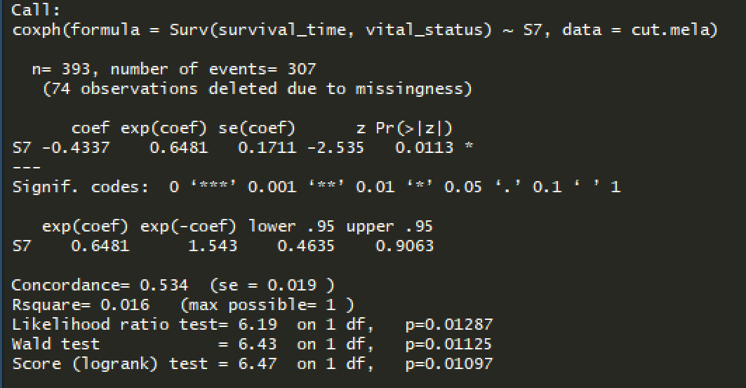
Signatures

Slide 38
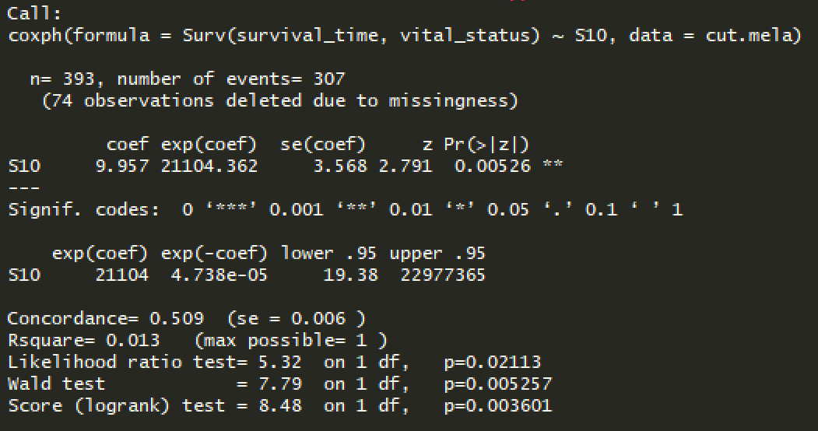
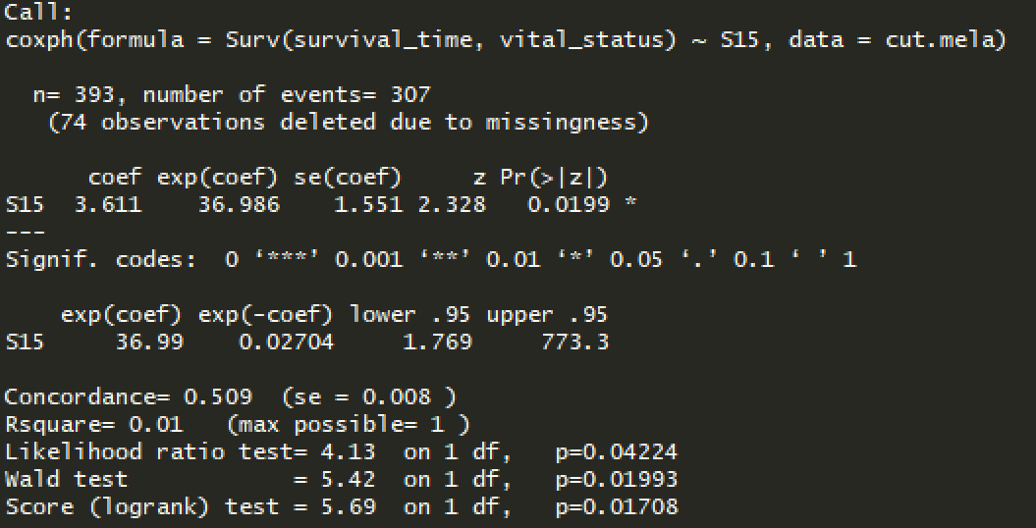
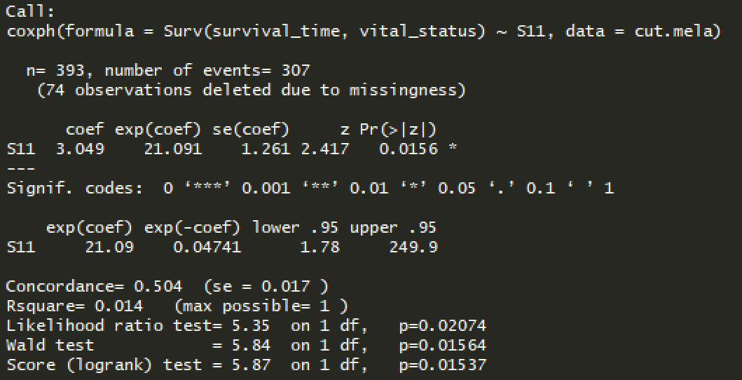
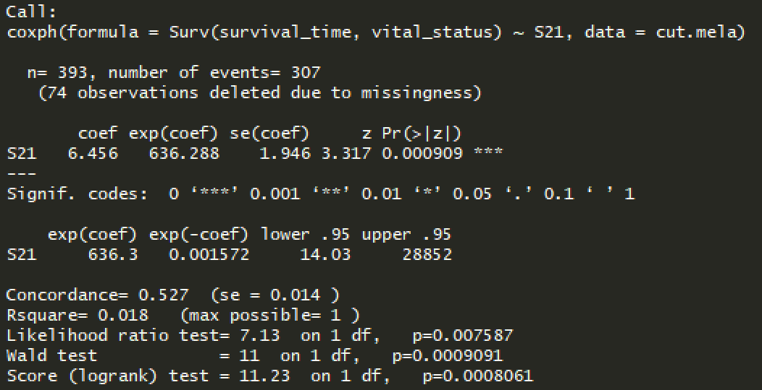
Signatures (2)

Slide 39
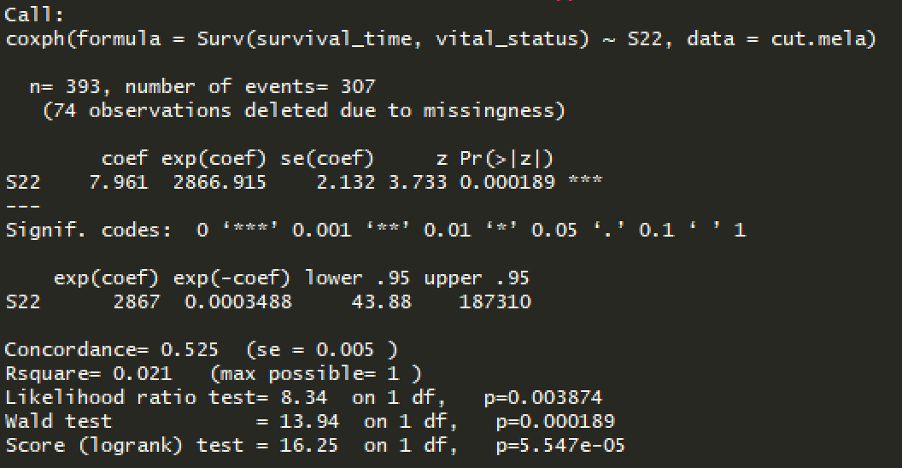
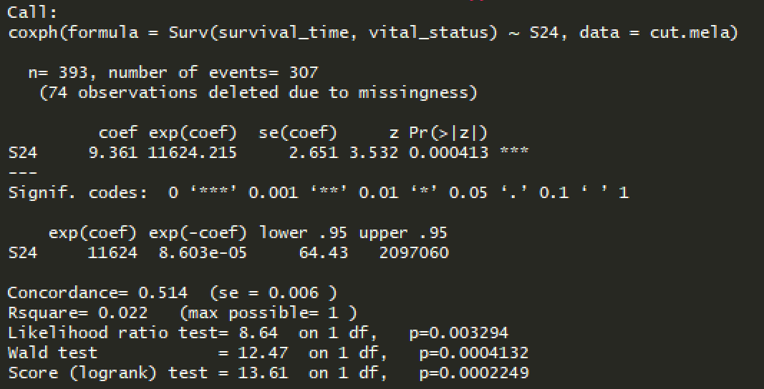
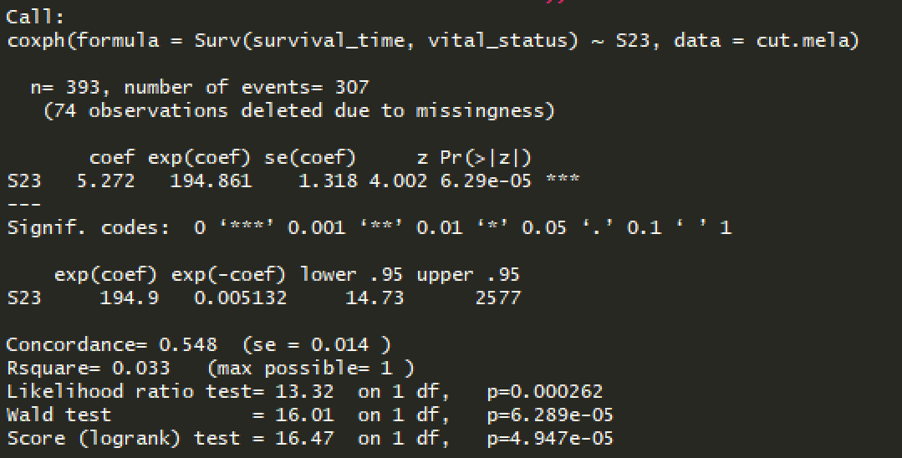
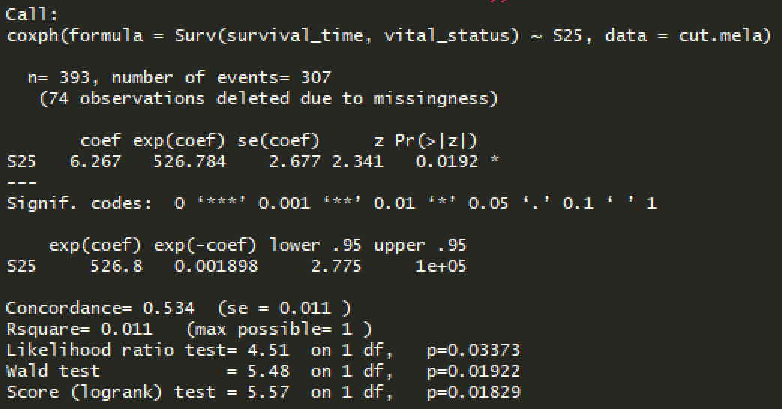
Signatures (3)

Slide 40
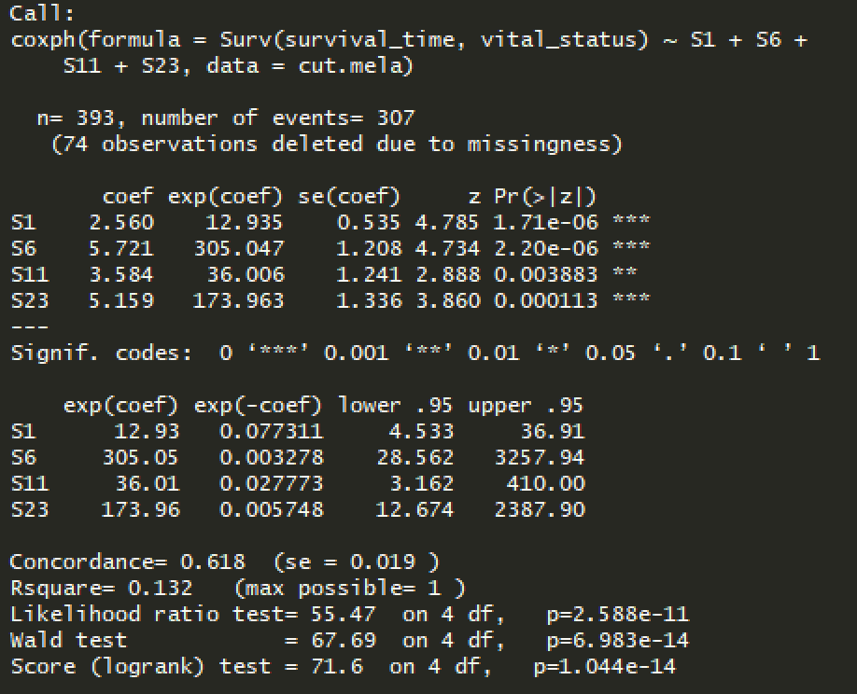
Signatures

Slide 41
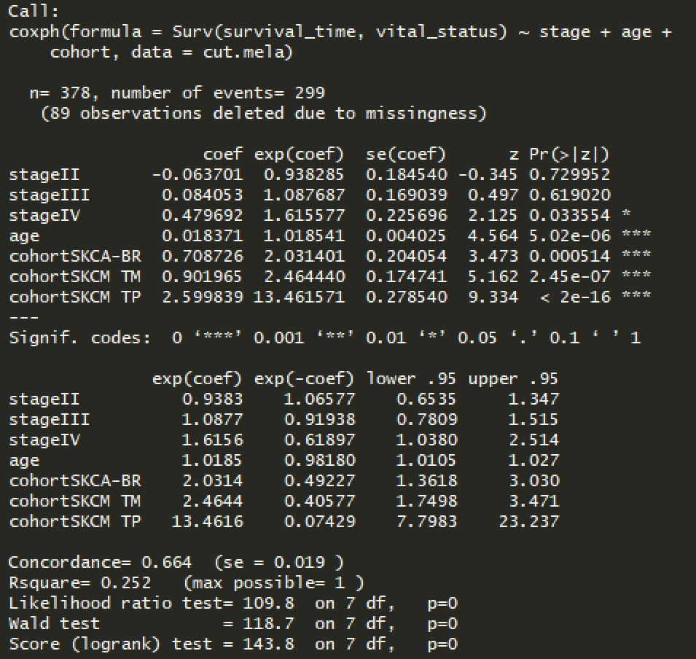
Clinical data

Slide 42
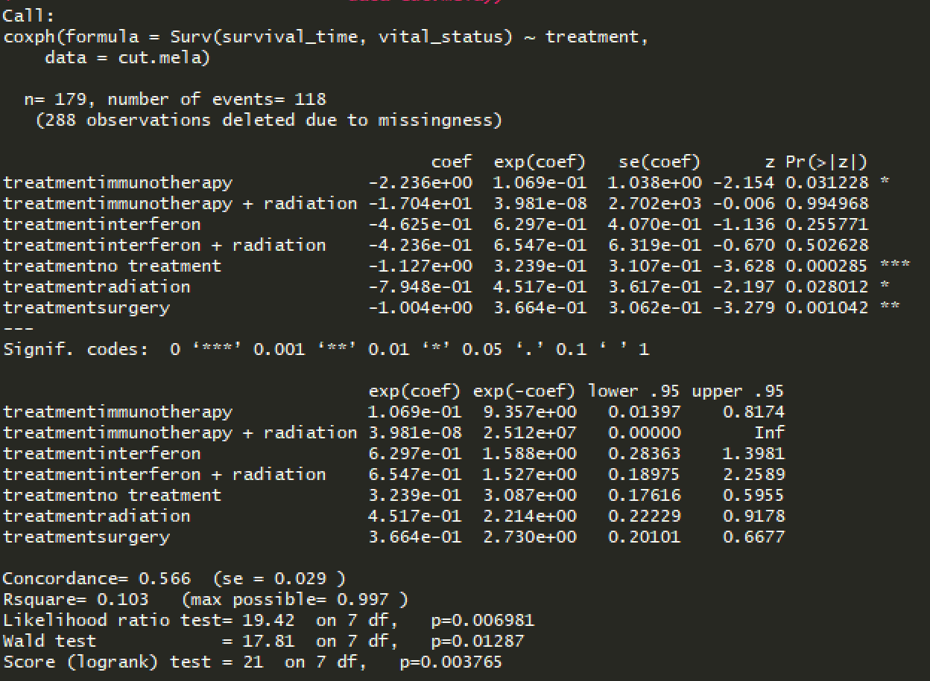
Treatment

Slide 43
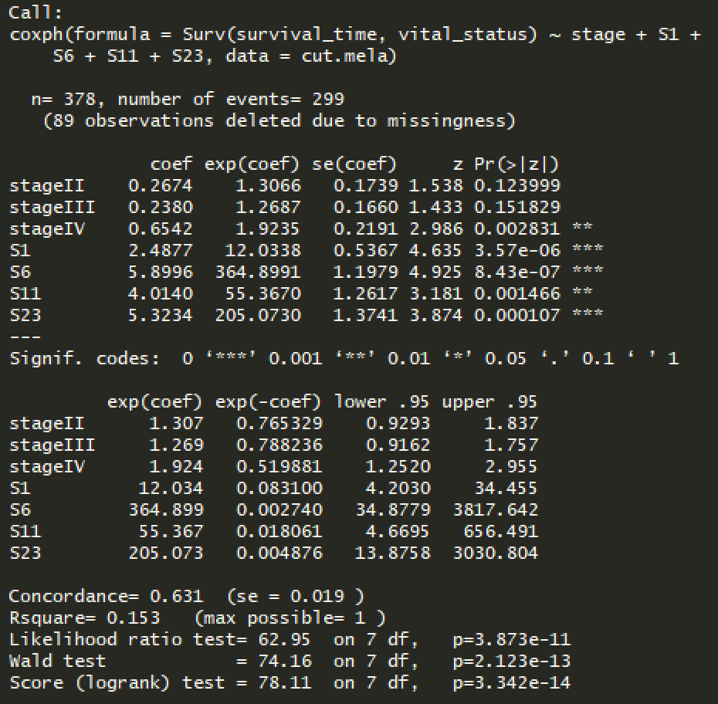
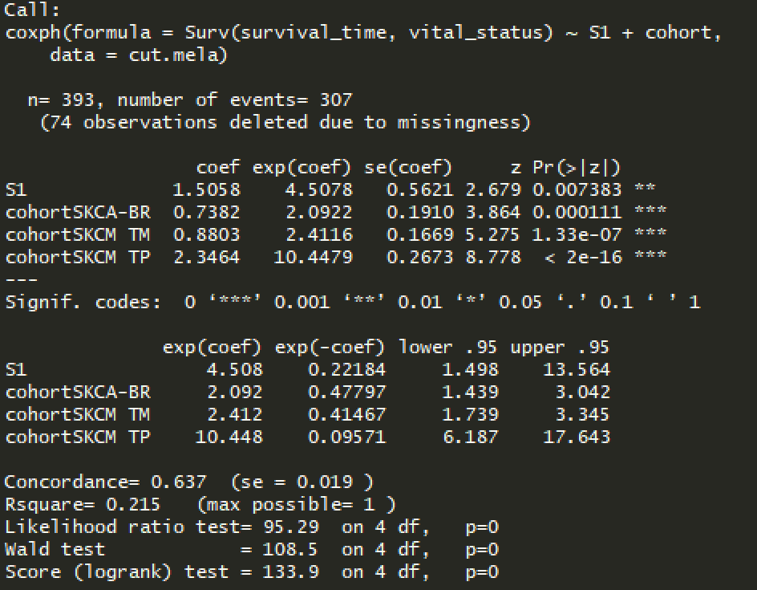
Without therapy
Notes:
Try excluding S1
If not improved: loss of NER/MMR signal, S1 due to higher prev, can be overshadowing effect of other sigs

Slide 44
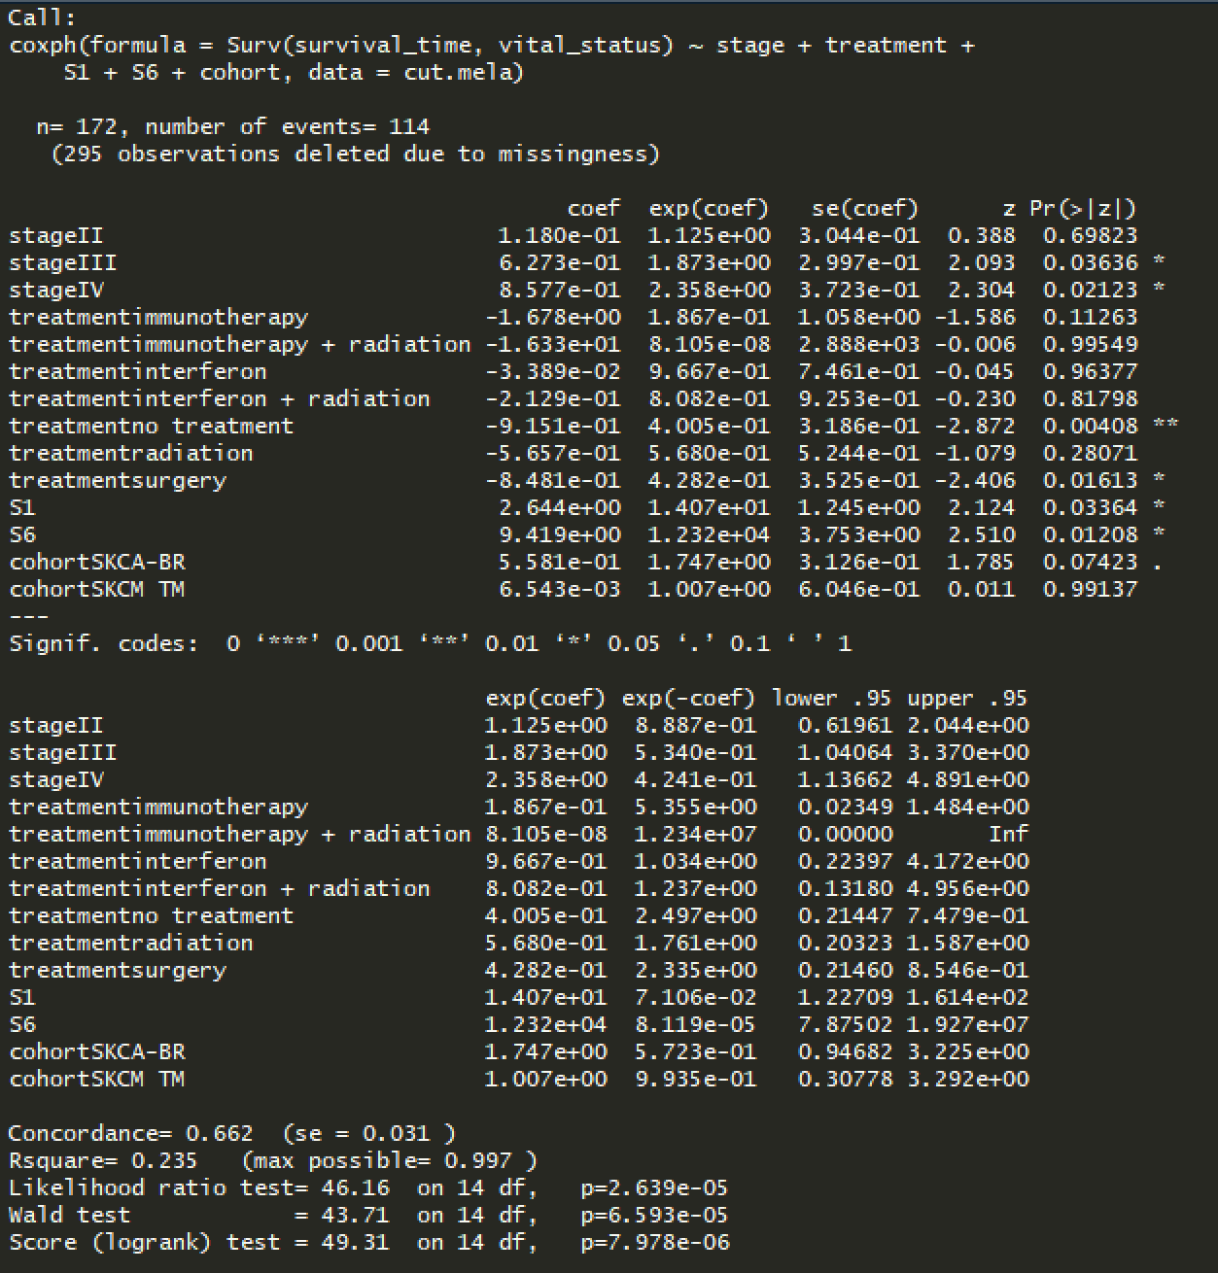
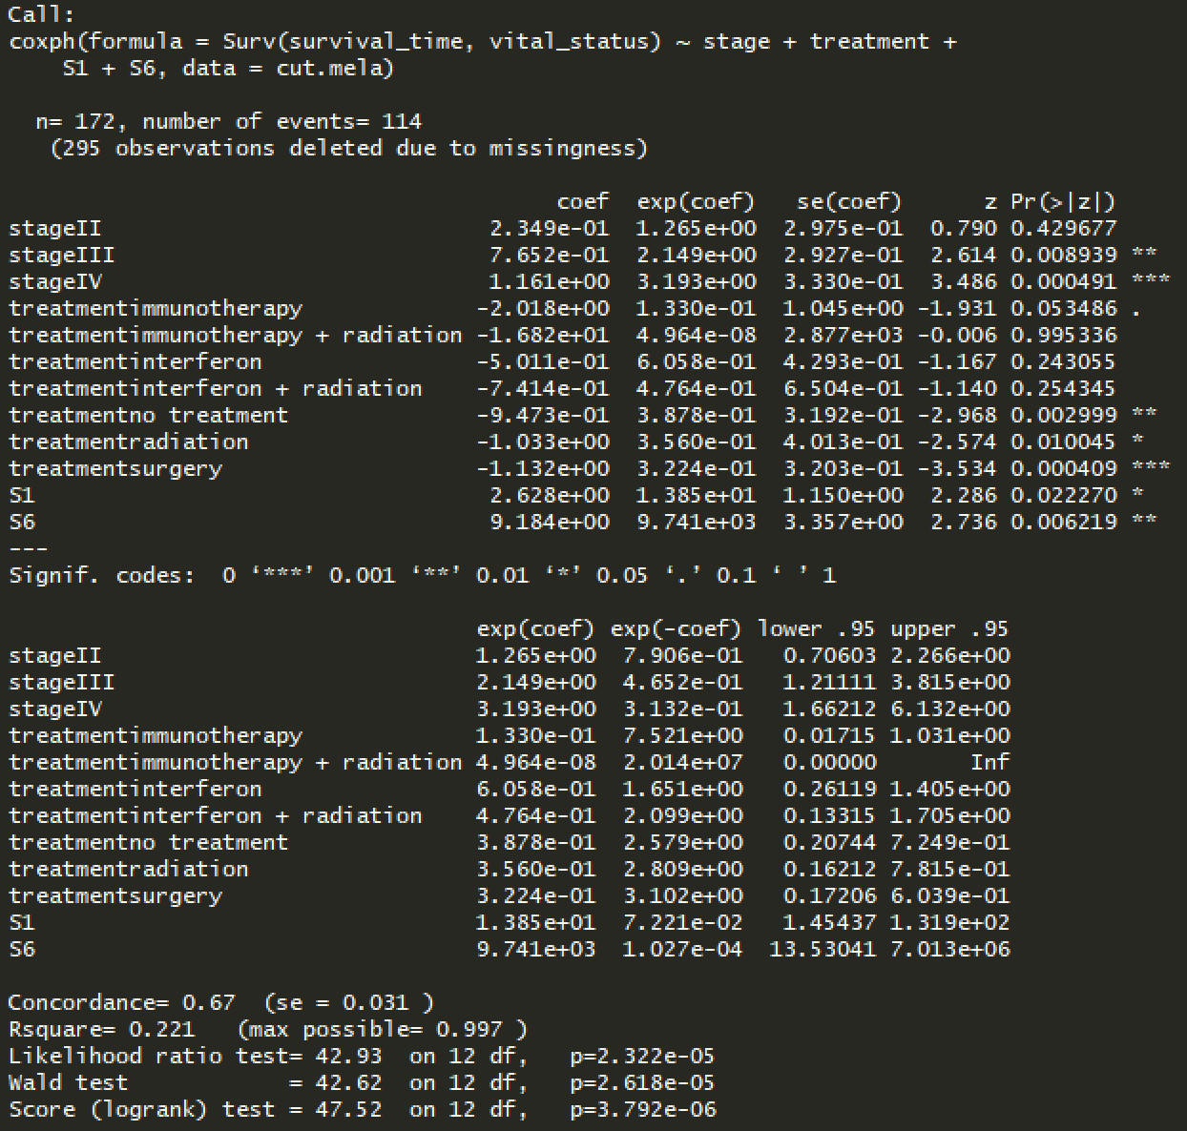
With therapy
Notes:
Try excluding S1
Run with combined MMR/NER sigs
KM plot of high vs low combined sigs on combined survival cohort
. Define cutoff by quartile (<25, 25-75, >75)
Corr combined sigs with metscore
Lookup pathway and survival/progression
Treatments quite general, could be that defects intro muts that make more resistant to radiation
Summary figure
. more visual (not a graph)
. Proposed mechanism progression of metastatic in melanoma
Metscore genes see if involved in same pathway → STRING, KEGG, Reactome, … don’t want to spend too much time → use genemania
. Table of top pathways
. Pathways involved in metastasis
Cancer is heterogeneous so difficult to find patterns

Slide 45
Survival
NER/MMR COMBINED SIGNATURES

Slide 46
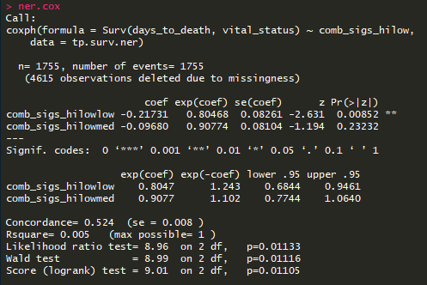
NER sigs survival

Slide 47
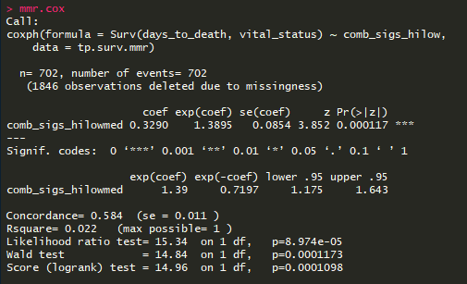
MMR sigs survival

Slide 49
Survival with NER/MMR
COMBINED COHORTS

Slide 50


No therapy

Slide 51

With therapy

Slide 52

With therapy
Combined radiation + immunotherapy and radiation + interferon into radiation + other

